Slide 1
United College Of Engineering & Research Naini Prayagraj
PPT on Soft Computing
For CS/IT Vth Semester
Unit 1

Slide 2
Topics
Co(Course Outcomes) of Subject.
Types of transfer functions
Neural network architecture
Single-layer feed forward network
Multilayer feed forward network
Perceptron
AssociativeMemory
Hetro-associative memory

Slide 3
Co(Course Outcomes) of Subject.
Co1 To devlop the skills to gain a basic understanding of neural network theory . Also explain the architecture of neural network, supervised & unsupervised learning.
Co2 To devlop the skills to gain the knowledge of various neural network models like perception model, single &multilayer model, back propagation model and its applications.
Co3 To understand the concept of fuzzy logic knowledge representation using fuzzy rules and fuzzy to crisp conversion.

Slide 4
Co(Course Outcomes) of Subject.
Co4 To devlop the knowledge of fuzzy membership & fuzzy rules and also their industrial applications.
Co5 To devlop the skills to gain a basic understanding of basic genetic algorithm techniques used in soft computing. Also some mutation generational cycle & its applications.

Slide 5
Artificial Neural Network
An artificial neutral network (ANN) is a system that is based on the biological neural network, such as the brain. The brain has approximately 100 billion neurons, which communicate through electro-chemical signals.
The ANN attempts to recreate the computational mirror of the biological neural network, although it is not comparable since the number and complexity of neurons and the used in a biological neural network is many times more than those in an artificial neutral network.

Slide 6
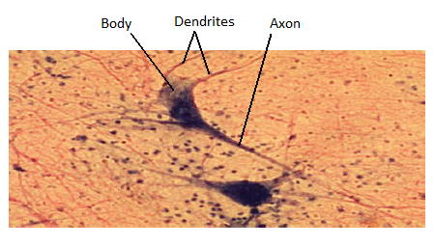

Slide 7
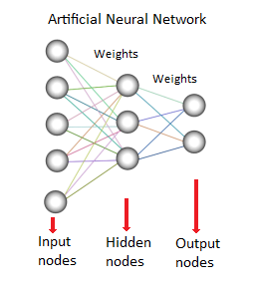
An ANN is comprised of a network of artificial neurons (also known as "nodes"). These nodes are connected to each other, and the strength of their connections to one another is assigned a value based on their strength: inhibition (maximum being -1.0) or excitation (maximum being +1.0). If the value of the connection is high, then it indicates that there is a strong connection. Within each node's design, a transfer function is built in. There are three types of neurons in an ANN, input nodes, hidden nodes, and output nodes.

Slide 8
The input nodes take in information, in the form which can be numerically expressed.
The information is presented as activation values, where each node is given a number, the higher the number, the greater the activation.
This information is then passed throughout the network. Based on the connection strengths (weights), inhibition or excitation, and transfer functions, the activation value is passed from node to node.
Each of the nodes sums the activation values it receives; it then modifies the value based on its transfer function.
The activation flows through the network, through hidden layers, until it reaches the output nodes.
The output nodes then reflect the input in a meaningful way to the outside world.

Slide 9
Transfer Functions
The transfer function translates the input signals to output signals. Four types of transfer functions are commonly used, Unit step (threshold), sigmoid, piecewise linear, and Gaussian.
An activation function performs a mathematical operation on the signal output.

Slide 10
Types of transfer functions
The transfer function (activation function) of a neuron is chosen to have a number of properties which either enhance or simplify the network containing the neuron.
Step function: The output y of this transfer function is binary, depending on whether the input meets a specified threshold, θ. The output is set to one, if the activation meets the threshold.

Slide 11
.
Linear combination
The output unit is simply the weighted sum of its inputs plus a bias term.
Sigmoid
The sigmoid function such as the logistic function also has an easily calculated derivative, which can be important when calculating the weight updates in the network

Slide 12
Neural network architecture
Architecture refers to the arrangement of neurons into layers and the connection patterns between layers, activation functions, and learning methods.
The model of Artificial neural network which can be specified by three entities:
Interconnections
Activation functions
Learning

Slide 13
There exist three basic types of neuron connection architecture :
1.Single-layer feed forward network
2.Multilayer feed forward network
3.Single node with its own feedback OR
(Recurrent N/W)
a. Single-layer recurrent network
b. Multilayer recurrent network

Slide 14
Single-layer feed forward network
This type of n/w consist of 2 layers :
Input layer
Output layer
The I/P layer neurons receive the I/P signal
The O/P layer neurons receive the O/P signal

Slide 15
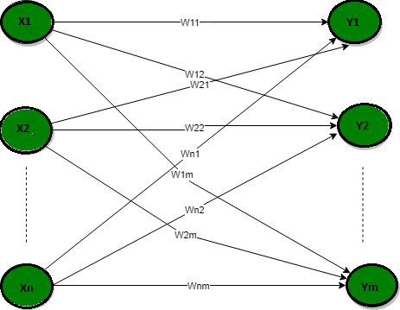
Single-layer feed forward network

Slide 16
Multilayer feed forward network
This n/w is made up of multiple layers.
It have more than one intermediate layer called hidden layer.

Slide 17
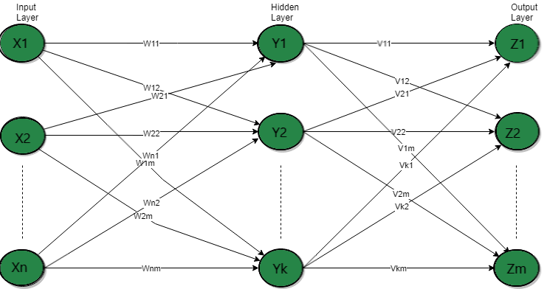
Multilayer feed forward network

Slide 18
Single node with its own feedback
(Recurrent N/W)
There is at least one feedback loop.
There can also be neurons with self feedback links.
The o/p of a neuron is back into itself as I/p.
This layer also has hidden layer which is ` internal to the network and has no direct contact with the external layer

Slide 19
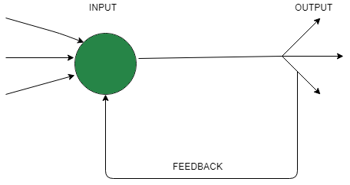
Single node with its own feedback
When outputs can be directed back as inputs to the same layer or preceding layer nodes, then it results in feedback networks.

Slide 20
Single-layer recurrent network
There can also be neurons with self feedback links.
The o/p of a neuron is back into itself as I/p.
In this N/W processing element’s output can be directed back to itself or to other processing element or both.

Slide 21
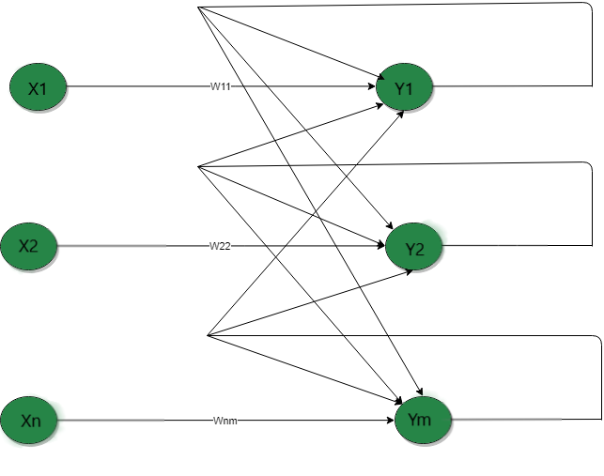
Single-layer recurrent network

Slide 22
Multilayer recurrent network
In this type of network, processing element
output can be directed to the processing element in the same layer and in the preceding layer forming a multilayer recurrent network.
They perform the same task for every element of a sequence, with the output being depended on the previous computations.

Slide 23
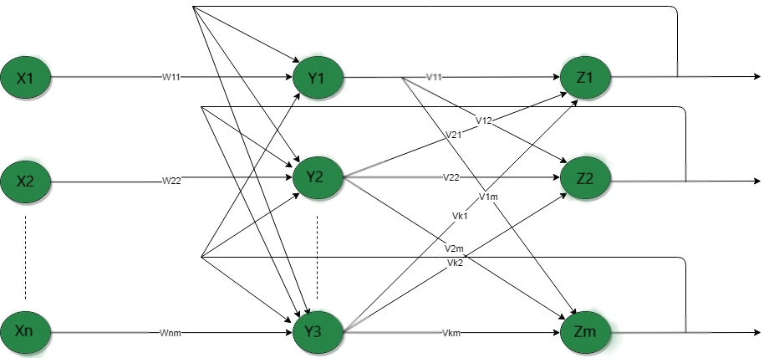
Multilayer recurrent network

Slide 24
Perception model
The perception is an algorithm for learning a binary classifier called a threshold function: a function that maps its input to an output
value (a single binary value)

Slide 26
Convergence rule
In this case, no "approximate" solution will be gradually approached under the standard learning algorithm.
There is an upper bound on the number of times the perceptron will adjust its weights during the training.

Slide 27
Auto Associative Memory
These kinds of neural networks work on the basis of pattern association, which means they can store different patterns and at the time of giving an output they can produce one of the stored patterns by matching them with the given input pattern.
These types of memories are also called Content-Addressable Memory CAM.

Slide 28
There are two types of associative memories
Auto Associative Memory
Hetero Associative memory

Slide 29
Auto Associative Memory
This is a single layer neural network in which the input training vector and the output target vectors are the same.
The weights are determined so that the network stores a set of patterns.

Slide 30
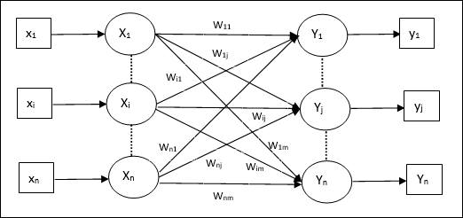

Slide 31
Hetro-associative Memory
Similar to Auto Associative Memory network, this is also a single layer neural network. However, in this network the input training vector and the output target vectors are not the same. The weights are determined so that the network stores a set of patterns. Hetero associative network is static in nature, hence, there would be no non-linear and delay operations.

